Slide 1
MySQL vs NoSQL
Muskan, Lukas, Priya

Slide 2
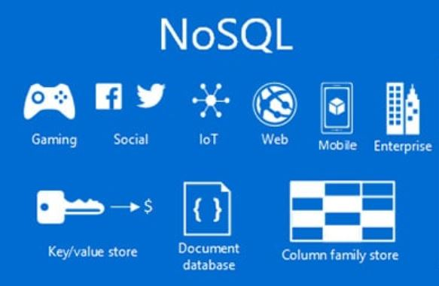
What is NoSQL? How is it used?
Stands for “not only SQL”
Similar to SQL
Efficient in large-scale data sets
Became mainstream in the mid-2000s

Slide 3
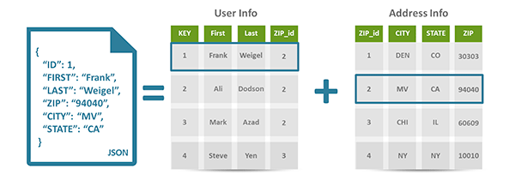
4 Main database types
Document Database
Different key value pairs, or key-array pairs, or even nested documents.
Allows developers at companies to create and update programs
E.g. couchbase server, documentDB, and mark logic

Slide 4
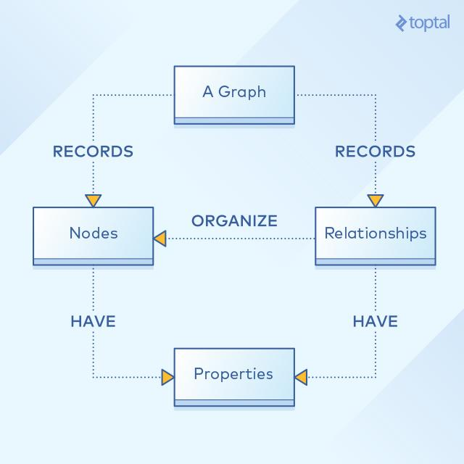
4 Main database types
Graph stores
a. stores information about networks of data
Relationship between nodes
Mapping relationships
E.g. Neo4J and Titan

Slide 5
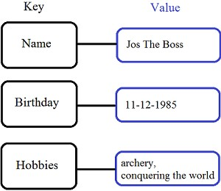
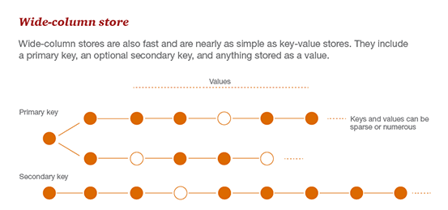
4 Main database types
Wide-column stores
Optimizes queries for large datasets, stores data together, instead of rows.
Store large data volumes faster
Key-value stores
Simplest NoSQL database
E.g. between Riak and Berkeley database.

Slide 6

What is MySQL?
Open source relational DBMS
Uses standard SQL
Backed by Oracle
Invented by David Axmark, Allan Larrson, Michael Widenius in 1995
Named after co-founder Michael’s daughter- My

Slide 7
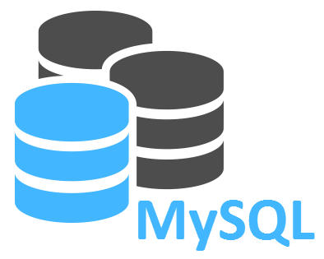
Components
MySql server
Utility programs
Supporting softwares

Slide 8
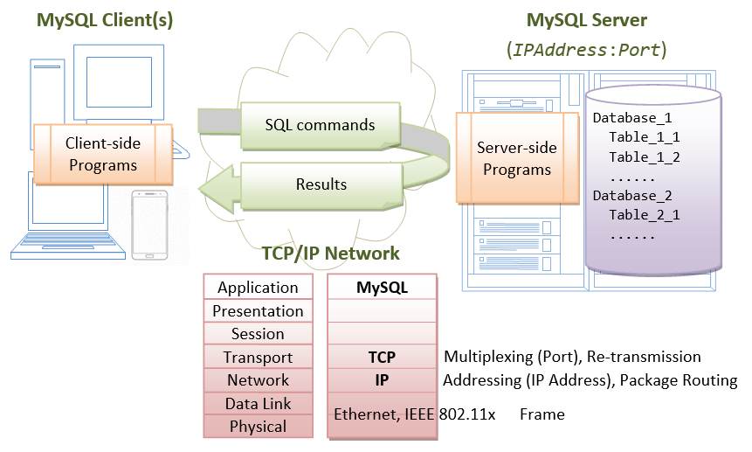

Slide 9
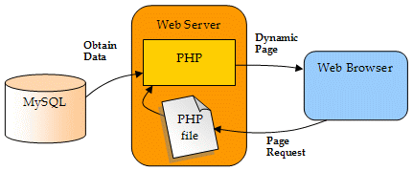
Web Database
Central component in LAMP (Linux, Apache, MySql, PHP) stack

Slide 10

Other uses
Data warehouse
E-commerce
Logging applications

Slide 11
Data Model
Language
Key Differences:
Scaling
Support

Slide 12
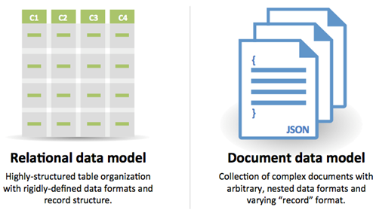
Data Models
MySQL: Relational
Data sorted into entities and attributes viewed in tables
Constrained by normalization and uniqueness
NoSQL: Non-Relational
Documents referring to each other by key-value
Not necessarily unique

Slide 13
Language
MySQL:
Uses SQL Language
Powerful use of statements
NoSQL:
Dynamic and efficient
Documents created rapidly without first being defined

Slide 14

Support & Documentation
SQL is mature and well-documented
Open-source options available
Newer, so solutions are still in development
NoSQL has dedicated community

Slide 15

Scaling: MySQL
MySQL is vertically-scalable
Increase load on single server by adding more CPU, RAM
Easy to add to existing schema

Slide 16

Scaling: NoSQL
NoSQL is horizontally-scalable
Handles traffic through sharding, adding servers
Potentially larger amounts of data in different structures

Slide 17
Conclusion:
MySQL is best for databases using a replicable schema and limited, powerful hardware.
NoSQL is best in cases where data is varied and needs to be updated quickly.

